Slide 1
Bigdata Analytics
Hadoop & Spark

Slide 2

Explosion of Data
We create 2.5 quintillion of data everyday
Data comes from various source and various format.
This enormous collection of data is Big Data.

Slide 3
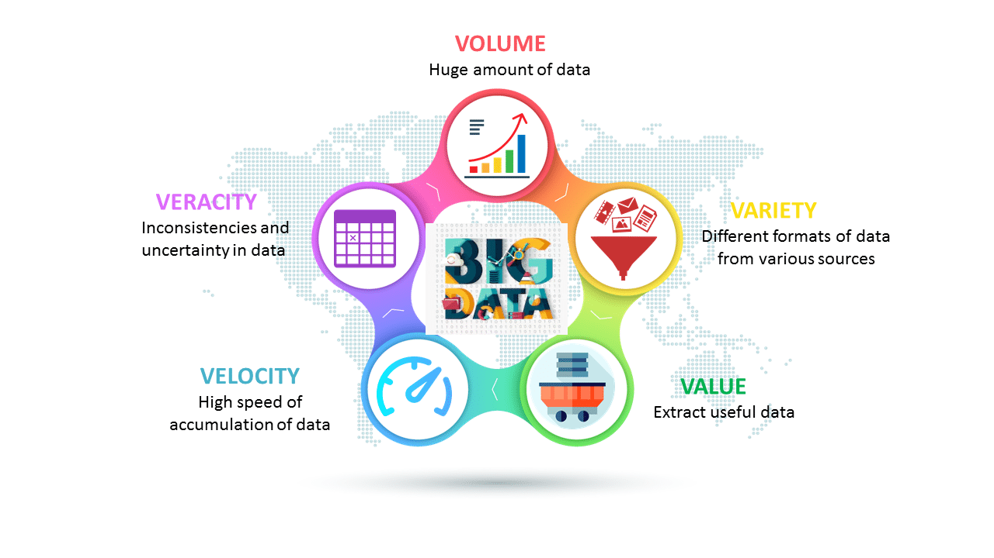
Characteristics of big data

Slide 4

Bigdata Analytics examines large and different types of data to uncover hidden pattern, correlation and other insight.

Slide 5
Big Data Analytics
Big Data definition : Big Data means a data that is huge in size. Bigdata is a term used to describe a collection of data that is huge in size and yet growing exponentially with time.
Big Data analytics examples includes stock exchanges, social media sites, jet engines, etc.
Big Data could be 1) Structured, 2) Unstructured, 3) Semi-structured
Volume, Variety, Velocity, and Variability are few Big Data characteristics
Improved customer service, better operational efficiency, Better Decision Making are few advantages of Bigdata

Slide 6
Hadoop
Hadoop is an Apache open-source framework written in java that allows distributed processing of large datasets across clusters of computers using simple programming models.
The Hadoop framework application works in an environment that provides distributed storage and computation across clusters of computers.
Hadoop is designed to scale up from a single server to thousands of machines, each offering local computation and storage.

Slide 7
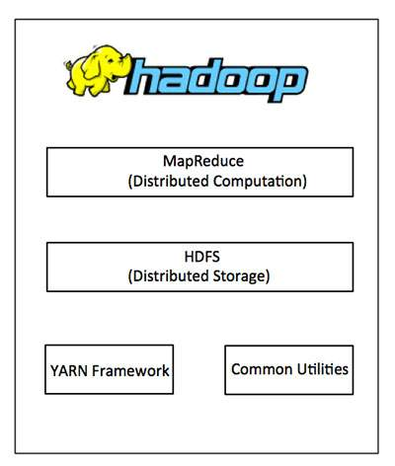
Hadoop Architecture
Processing/Computation layer (MapReduce)
Storage layer (Hadoop Distributed File System)

Slide 8
How Does Hadoop Work?
Hadoop stores a massive amount of data in a distributed manner in HDFS.
The Hadoop MapReduce is the processing unit in Hadoop, which processes the data in parallel.
Hadoop YARN is another core component in the Hadoop framework, which is responsible for managing resources amongst applications running in the cluster and scheduling the task.

Slide 9
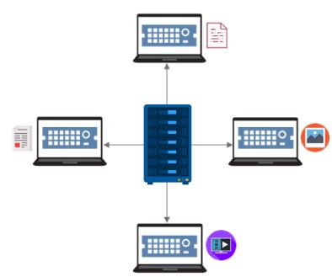
HDFS
HDFS is a specially designed file system for storing huge datasets in commodity hardware, storing information in different formats on various machines.

Slide 10
HDFS Component
NameNode - NameNode is the master daemon.
There is only one active NameNode.
It manages the DataNodes and stores all the metadata.
DataNode - DataNode is the slave daemon.
There can be multiple DataNodes.
It stores the actual data

Slide 11
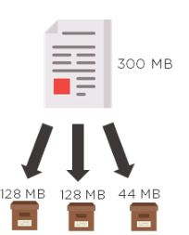
HDFS
HDFS splits the data into multiple blocks, defaulting to a maximum of 128 MB.
The default block size can be changed depending on the processing speed and the data distribution

Slide 12
MapReduce
MapReduce is a software framework and programming model used for processing huge amounts of data.
Hadoop MapReduce processes the data stored in Hadoop HDFS in parallel across various nodes in the cluster.
It divides the task submitted by the user into the independent task and processes them as subtasks across the commodity hardware.
Notes:
MapReduce program work in two phases, namely, Map and Reduce.
Map tasks deal with splitting and mapping of data while Reduce tasks shuffle and reduce the data.

Slide 13
How MapReduce Organizes Work?
Hadoop divides the job into tasks.
Map tasks (Splits & Mapping)
Reduce tasks (Shuffling, Reducing)
The complete execution process (execution of Map and Reduce tasks, both) is controlled by two types of entities called a
Jobtracker: Acts like a master (responsible for complete execution of submitted job)
Multiple Task Trackers: Acts like slaves, each of them performing the job

Slide 14
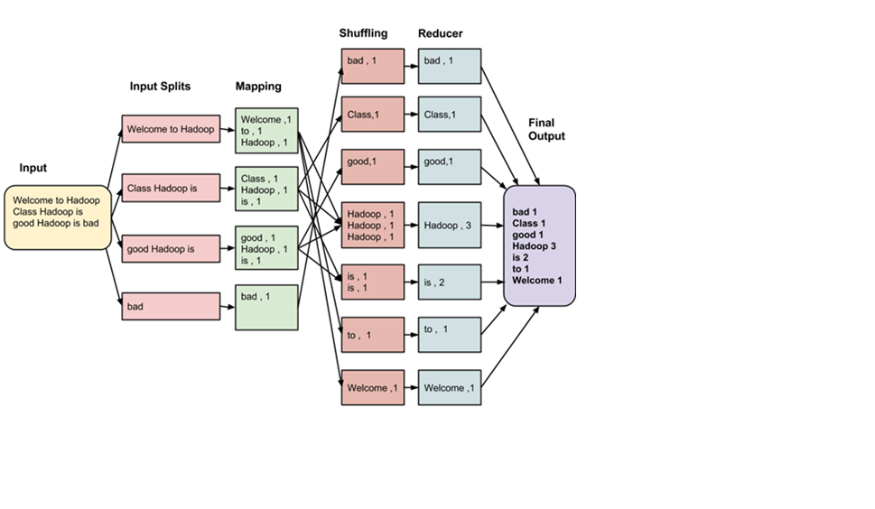
MapReduce Architecture

Slide 15
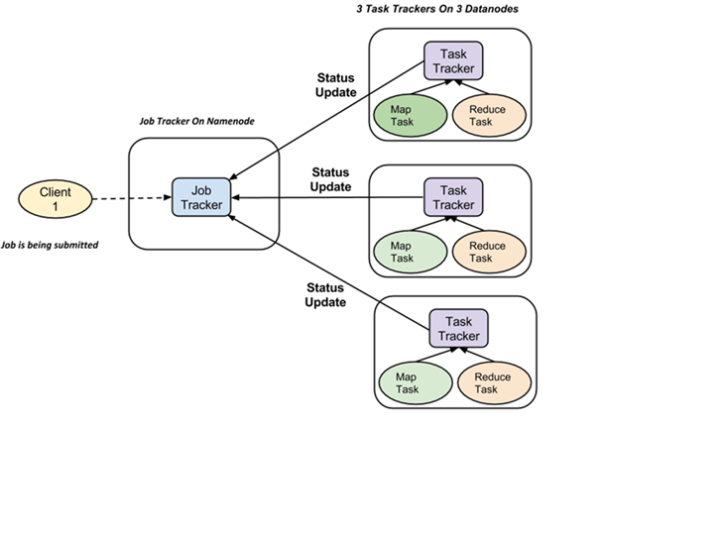
MapReduce Architecture
A job is divided into multiple tasks which are then run onto multiple data nodes in a cluster.
It is the responsibility of job tracker to coordinate the activity by scheduling tasks to run on different data nodes.
Execution of individual task is then to look after by task tracker, which resides on every data node executing part of the job.

Slide 16
MapReduce Architecture
Task tracker’s responsibility is to send the progress report to the job tracker.
In addition, task tracker periodically sends ‘heartbeat’ signal to the Jobtracker so as to notify him of the current state of the system.
Thus job tracker keeps track of the overall progress of each job. In the event of task failure, the job tracker can reschedule it on a different task tracker.

Slide 17
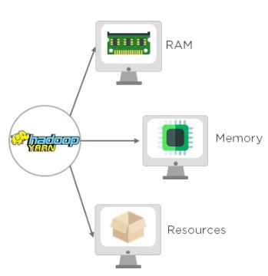
YARN (Yet Another Resource Negotiator)
It handles the cluster of nodes and acts as Hadoop’s resource management unit.
YARN allocates RAM, memory, and other resources to different applications.

Slide 18
YARN Component
Resource Manager (Master) - This is the master daemon. It manages the assignment of resources such as CPU, memory, and network bandwidth.
Node Manager (Slave) - This is the slave daemon, and it reports the resource usage to the Resource Manager.

Slide 19
Advantages of Hadoop
Hadoop framework allows the user to quickly write and test distributed systems. It is efficient, and it automatic distributes the data and work across the machines and in turn, utilizes the underlying parallelism of the CPU cores.
Hadoop does not rely on hardware to provide fault-tolerance and high availability (FTHA), rather Hadoop library itself has been designed to detect and handle failures at the application layer.
Servers can be added or removed from the cluster dynamically and Hadoop continues to operate without interruption.
Another big advantage of Hadoop is that apart from being open source, it is compatible on all the platforms since it is Java based.

Slide 20
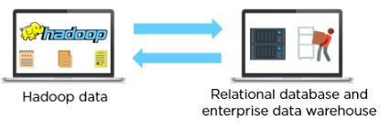
Sqoop
Sqoop is used to transfer data between Hadoop and external datastores such as relational databases and enterprise data warehouses.
It imports data from external datastores into HDFS

Slide 21
Hive
Hive is a data warehouse system which is used to analyze structured data. It is built on the top of Hadoop. It was developed by Facebook.
Hive provides the functionality of reading, writing, and managing large datasets residing in distributed storage. It runs SQL like queries called HQL (Hive query language) which gets internally converted to MapReduce jobs.

Slide 22
HIVE
Using Hive, we can skip the requirement of the traditional approach of writing complex MapReduce programs.
Hive supports Data Definition Language (DDL), Data Manipulation Language (DML), and User Defined Functions (UDF).

Slide 23
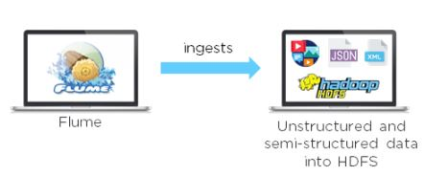
Flume
Flume is another data collection and ingestion tool, a distributed service for collecting, aggregating, and moving large amounts of log data.
It ingests online streaming data from social media, logs files, web server into HDFS.

Slide 24
Pig
Pig is a high-level programming language useful for analyzing large data sets.
Pig was a result of development effort at Yahoo!
In a MapReduce framework, programs need to be translated into a series of Map and Reduce stages. However, this is not a programming model which data analysts are familiar with.
So, in order to bridge this gap, an abstraction called Pig was built on top of Hadoop

Slide 25
Pig
Apache Pig enables people to focus more on analyzing bulk data sets and to spend less time writing Map-Reduce programs.

Slide 26
Pig Architecture
The Architecture of Pig consists of two components:
Pig Latin, which is a language
A runtime environment, for running PigLatin programs.

Slide 27
Pig Architecture
A Pig Latin program consists of a series of operations or transformations which are applied to the input data to produce output.
These operations describe a data flow which is translated into an executable representation, by Hadoop Pig execution environment. Underneath, results of these transformations are series of MapReduce jobs which a programmer is unaware of.

